Slide 1

FINAL PROJECT
PREDICT PRICE OF THE STOCK

Slide 2

1. Introduction
2. Dataset
OUTLINE
3. Visualize and analysis
4. Predict by using LSTM

Slide 3


1.INTRODUCTION
Based on available stock price data using LSTM to predict future prices
Input: price stock data
Output: future stock prices

Slide 4

2. DATASET

Slide 5
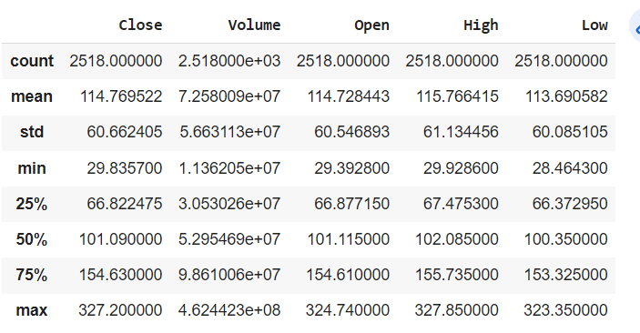
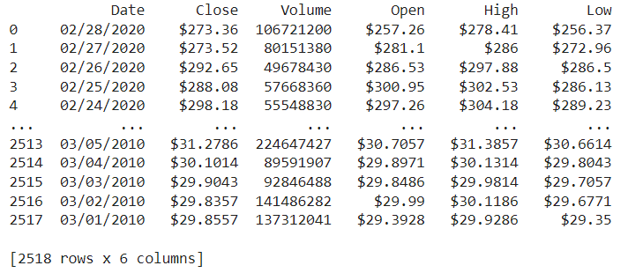

Slide 6
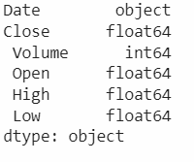
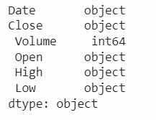

Slide 7
3. VISUALIZE AND ANALYSIS

Slide 8
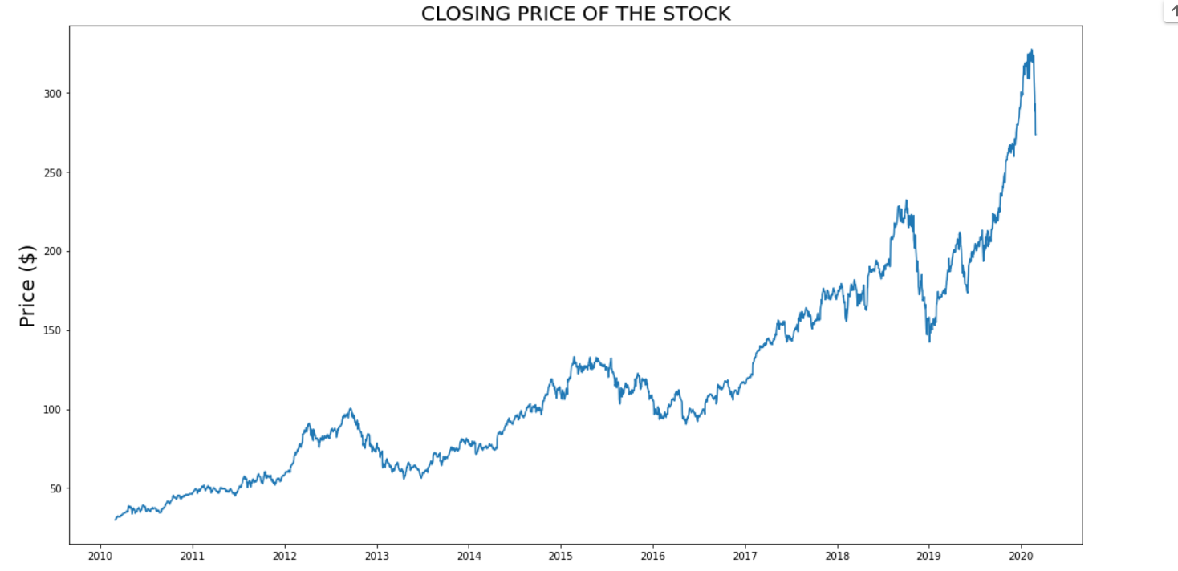

Slide 9
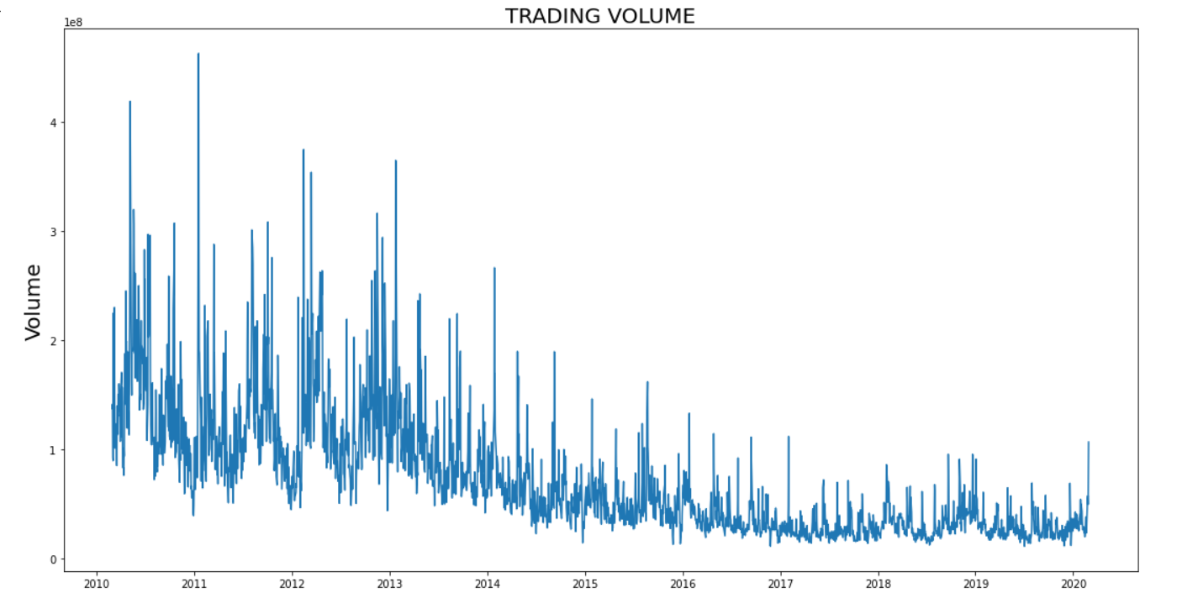

Slide 10
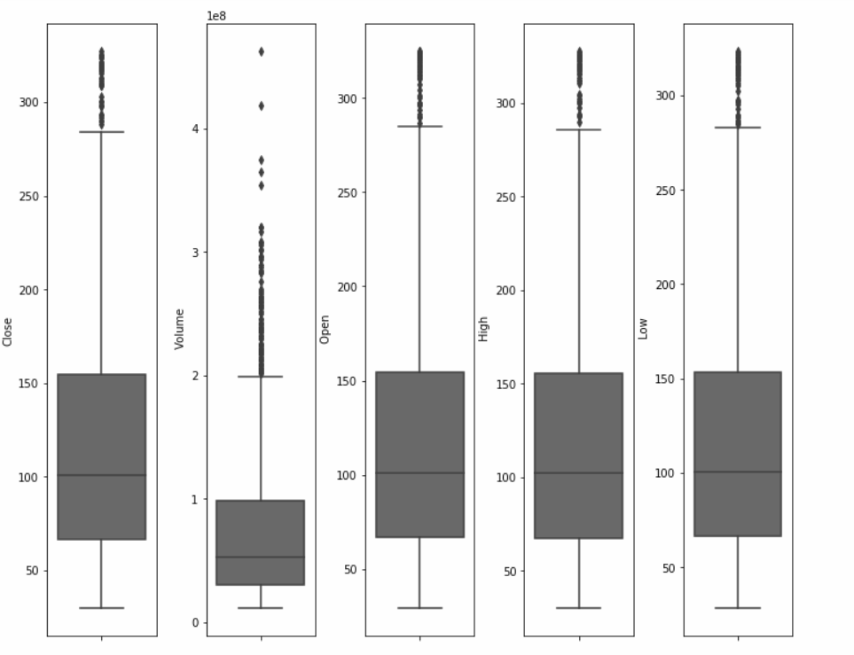
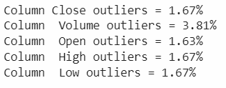

Slide 11
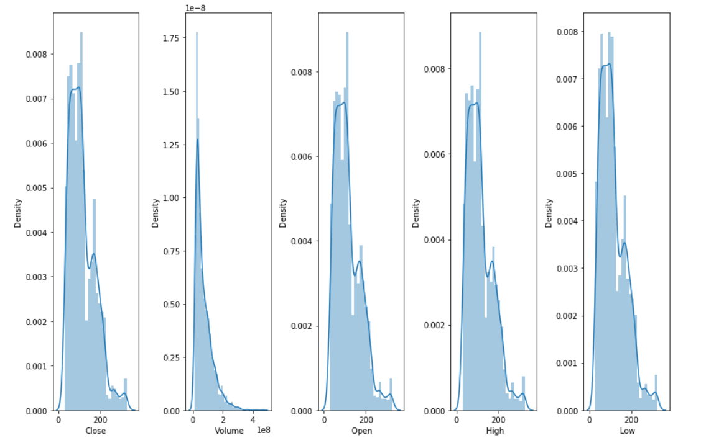

Slide 12
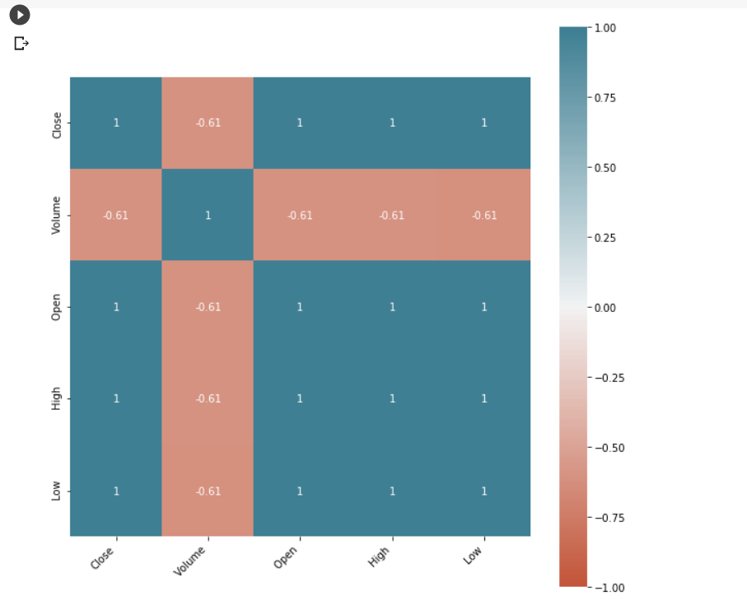

Slide 13
4. PREDICT BY USING LTSM

Slide 14
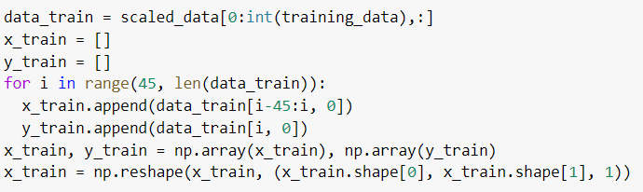
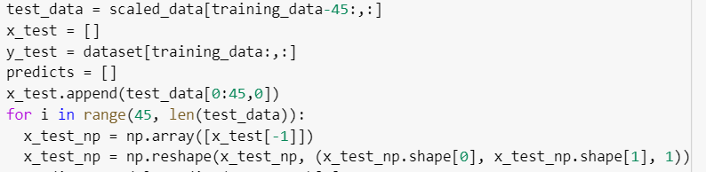

Slide 15
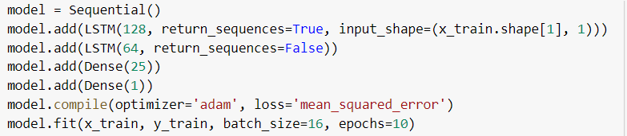

Slide 16
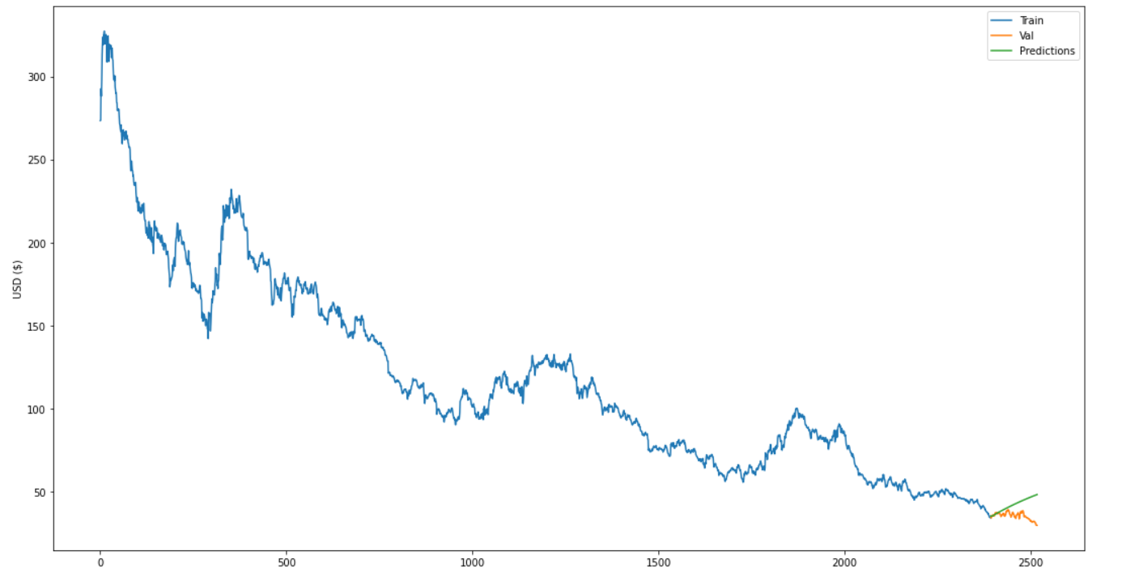

Slide 17
Thank you for litstening

